Slide 1

Data Science Institute Final Project
January 15, 2021
PREPARED FOR
Colleen Mattingly, Emma Eichelman, Rasmus Jonsson
Professor Ryan Moore,
Simon Heuberger
Notes:
[Rasmus] - “Please limit your talk to 15 mnutes”

Slide 2
Today’s Agenda
Introduction
Our hypothesis
Methodology
Variables Used
Models
Analysis
Graphs
02
Q&A
| Final Presentation
Notes:
Not sure if this slide will be necessary bc we have limited time, up to you guys

Slide 3
Climate Change
US Public Opinion
Impacts of Natural Disasters
Introduction
03
| Final Presentation
Notes:
Rasmus
Probably should reference specific studies here on impacts of climate change on natural disasters to explain why we chose our research question

Slide 4
Q: Does a person’s location (based on state within the United States) influence their feelings towards climate change?
Question & Hypothesis
H: The presence of a state emergency will increase respondent’s belief in climate change.
04
| Final Presentation
Notes:
Rasmus

Slide 5
Data used:
NSEE public opinion surveys - climate change sentiment
Focused on 2010, 2014, 2018
Open FEMA data - disasters by state
Severe storm, hurricane, fire
Data wrangling
Methodology
05
| Final Presentation
Notes:
Emma
NSEE = National Survey on Energy and the Environment
Public opinion survey data obtained through randomized phone calls (US only)
Asks demographic questions and a series of yes/no and scale (?) sentiment question all around climate change and energy policies in the US
FEMA data
Open source data that records disasters by US state and territories by year
Disasters included anything that FEMA declares a state emergency - hurricane, fire, mudslide, tsunami, earthquake, etc.
Focused on the previous year FEMA data to survey opinion data - 2009, 2013, 2017
The reason the years previous to the survey data were used was to make sure there wasn’t a misalignment with timing of potential disasters and the collection of the survey responses. We chose to narrow the results by severe storm, hurricanes, and fire as those are three natural disasters.
Data cleaning:
Needed to do a lot amount of data wrangling prior to our formal analysis
Combined the FEMA data and NSEE data by creating a new variable using state information from NSEE data and coded it as a “1” if that state had experienced a natural disaster, based on FEMAs data for that year, and a “0” if not
Responses containing no response or a “not sure” response for any of the variables we wanted to test were removed
Led to a loss of observations, will touch on later on in the presentation
From there, we selected the specific variables that we wanted to analyze and made necessary adjustments depending on the variable
for example, race and Year were considered numbers in the NSEE survey and they needed to be changed to factors to be used in the analysis
The yes/no responses for the question regarding belief and climate change were recoded to 0 and 1 so that they would be binary
Finally, each year contained the same variables so we were able to combine into one complete data set that included responses year over year

Slide 6
Race - factor
Age - number
Income - number
Education - number
State
Belief in climate change - binary (Yes/No response)
Natural disasters by region - binary (“1” = disaster, “0” = no disasters)
Variables
06
| Final Presentation
Notes:
Emma
Although the focus of our hypothesis is on gw_belief and state emergencies, we still included these other variables in our analysis to compare how different factors influence someone’s feelings towards climate change over time
Question “Is there solid evidence that the average temperature on earth has been getting warmer over the past four decades?” was the main focus for this analysis
Should we explain the legends or not necessary?

Slide 7
Basic proportion tests
Generalized Linear Model
Data limitations
Models
07
| Final Presentation
Notes:
Colleen
Began with a basic proportion test and tapply() - compares means of two variables
Limitations with binary variables and sample size - made cluster analysis and others difficult
Group members had limited statistical background

Slide 8
Analysis
We ran our glm separately for each year: 2010, 2014, and 2018:
logit_b <- glm(gw_belief ~ demog_race + demog_age_list + demog_edu + demog_income + state_emergency, family = binomial, data = df.beg_final)
summary(logit_b)
2010- No conclusions could be drawn from this model.
2014- We found that the student group interpreted that while the overall age increased, the belief in climate change decreased.
2018- Age continued to be the most significant factor with belief in climate change increasing as age increases. State emergency had a positive correlation in 2018, but was not statistically significant so no conclusions could be drawn on how an increase in natural disasters impacts belief in climate change.
*We could not reject our null hypothesis.
09
| Final Presentation
Notes:
Colleen

Slide 9
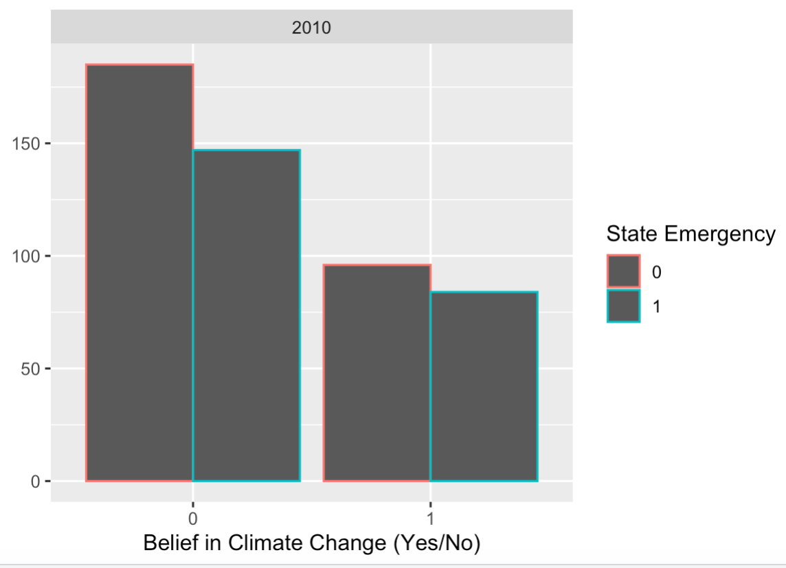
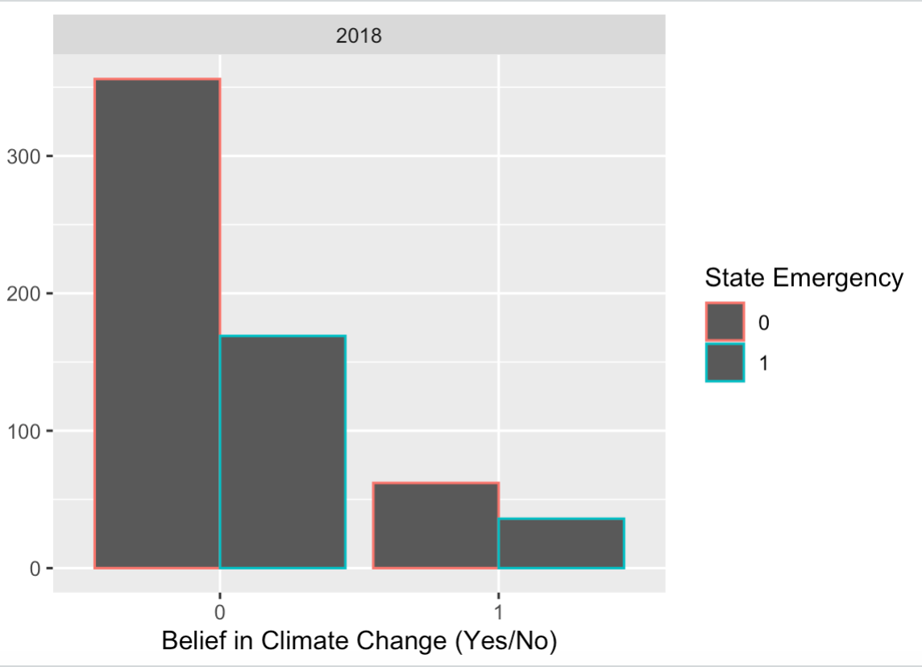
Graphs
08
| Final Presentation
Notes:
Colleen
Red vs. Green shows whether there was a state emergency in the prior year of the survey. The x-axis shows whether they answered yes or no for belief in climate change (0 for no, 1 for yes).
Discuss challenges of graphs when majority of data is categorical and binomial
Graphs support statistical analysis

Slide 10
Time constraint
Finding data
NSEE survey - respondents are not required to answer every question
Led to lost observations
Unable to distinguish total # of natural disasters per state, per year
Potential for influence of variables not included in our study
Limitations
10
| Final Presentation
Notes:
[Rasmus]

Slide 11
Questions?
11
| Final Presentation

